Slide 1

DEPARTMENT OF CSE (ARTIFICIAL INTELLIGENCE AND MACHINE LEARNING) ACADEMIC YEAR 2025 - 2026 SEMESTER III ARTIFICIAL INTELLIGENCE LABORATORY MINI PROJECT REVIEW WATER JUG PROBLEM SOLVER
REGISTER NUMBER | 2117240030026
NAME | DEVIHARINI.M
YEAR | 2
SECTION | A
FACULTY IN-CHARGE | Mrs. M. Divya

Slide 2
INTRODUCTION
The Water Jug Problem is a classic AI problem used to demonstrate state-space search.
Objective: Measure an exact amount of water using two jugs with different capacities.
In this mini project, the Depth First Search (DFS) algorithm is used to find a solution path

Slide 3
PROBLEM STATEMENT
Given two jugs with capacities A and B liters, and an unlimited water supply:
Find a sequence of steps to measure exactly C liters of water using the jugs.
Example: Jug A = 4L, Jug B = 3L, Goal = 2L.

Slide 4
THEORETICAL BACKGROUND
DFS explores as far as possible along a branch before backtracking.
Key features:
Stack-based implementation (recursive or iterative)
May not always find the shortest path, but guarantees completeness in finite state spaces.
Ideal for exploring large but finite problem spaces like the water jug problem.

Slide 5
IMPLEMENTATION AND CODE
Link to code in Git-hub Repository
List | Git-hub Repository Links
Implementation of Code Link | https://github.com/deviharini805-alt/Water-jug-problem-solver-/blob/main/Program
Word Document Report Link | https://github.com/deviharini805-alt/Water-jug-problem-solver-/blob/main/I%20am%20sharing%20'harini%20ai%20miniproject%202'%20with%20you.pdf
PPT Link

Slide 6
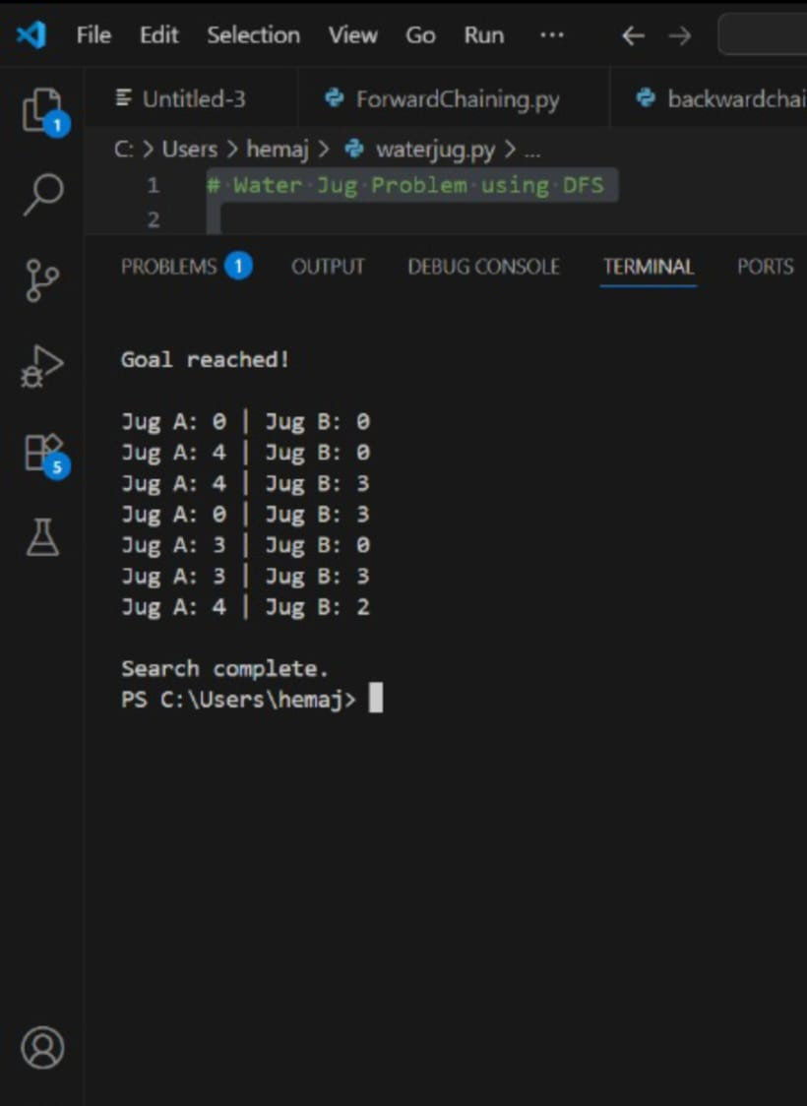
OUTPUT AND RESULTS
Output:
The program starts with both jugs empty — (0, 0) — and uses the Depth First Search (DFS) algorithm to explore all possible actions like filling, emptying, and pouring water between the jugs.Step by step, the algorithm tries different moves until it reaches a state where one jug has exactly 2 liters of water.The sequence of states found is:(0,0) → (4,0) → (1,3) → (1,0) → (0,1) → (4,1) → (2,3)At the final state (2, 3), Jug 1 contains 2 liters, which is the goal.Thus, the program successfully solves the problem using DFS by exploring possible water transfers and finding a valid solution path.

Slide 7
OUTPUT AND RESULTS
RESULT:
The program starts with both jugs empty and applies the Depth First Search (DFS) algorithm to explore all possible ways of filling, emptying, and pouring water between the two jugs.Through this process, the algorithm finds a valid sequence of actions that results in exactly 2 liters of water in one of the jugs.
Future Enhancement :
Add a Graphical User Interface (GUI) to visualize jug operations step by step.
Implement other AI algorithms like BFS or A* to find the shortest path.
Allow user input for different jug sizes and target values.
Compare performance of DFS with other search methods.
Develop a mobile or web app version for interactive learning.

Slide 8
REFERENCES
Artificial Intelligence: A Modern Approach (3rd Edition) by Stuart Russell and Peter Norvig — Chapter on Search Strategies.
GeeksforGeeks: “Water Jug Problem using DFS” — https://www.geeksforgeeks.org/water-jug-problem-using-dfs/
Tutorialspoint: “AI Search Algorithms - Depth First Search”
GitHub Repositories: Example Python Implementations of Water Jug Problem
AI Practical Lab Manual (University reference materials) — Unit on Search-Based Problem Solving.

